Slide 1
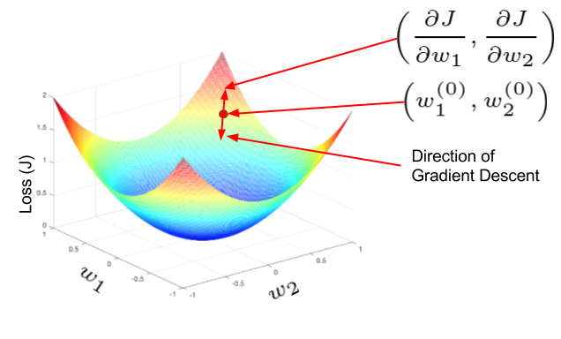
Cancer Subtyping by Applying a Multimodal Deep Learning Network to both Whole Slide Images and RNA-Seq Data
One Year Confirmation Seminar
Peter Donnelly
10 October 2020
peter.donnelly@petermac.org
Gradient Descent: the main opimization algorithm used in neural networks
Understanding Activation Functions in Deep Learning - Aditya Sharma

Slide 2

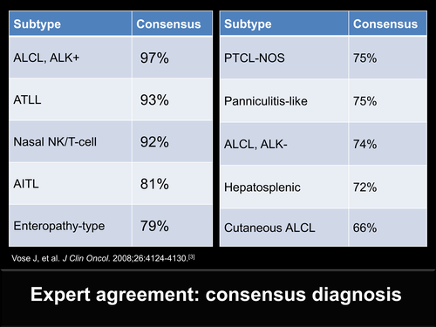
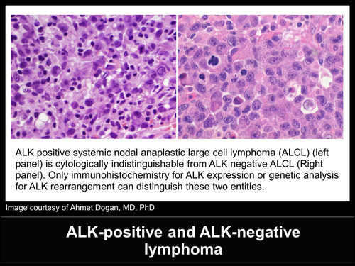
Overview
Premise
Some kinds of cancers are difficult to sub-type using histopathology images alone
In such cases, immunohistochemistry or molecular testing can provide additional information to differentiate such morphologically near identical subtypes
Proposition
A supervised multi-modal neural network trained with matched heterogeneous sample types, namely (1) high resolution scans of tissue samples, and (2) gene expression data derived from RNA sequencing, may be an effective tool for automatically sub-typing cancers generally, and difficult to classify cancers such as certain T-Cell Lymphoma sub-types in particular
Testing
The proposition will be validated or rejected by conducting experiments on matched WSI and RNA-Seq data using appropriate neural network algorithms and models. The development and delivery of a suitable experiment system is a key thesis deliverable.
The ALK-negative and ALK-positive sub-types of Anaplastic Large Cell Lymphoma (ALCL) have almost identical histomorphologies, and normally cannot be differentiated visually. This is consequential, since the ALK-positive sub-type has a much better prognosis than the ALK-negative sub-type, and the optimum treatment for each differs.
Inter-expert agreement on diagnosis
A Pathologist’s Guide to Accurate Diagnosis of Peripheral T-Cell Lymphona
Notes:
So relating this to my thesis, the main proposition is that a particular kind of neural network called a multi-modal neural network, which is able to accept and learn from more than one data modality– in our case image data AND gene expression data – might be effective at lymphoma classification; and more effective at lymphoma classification than a network that uses just one of these data modes, and might hopefully be able to differentiate some of the more difficult to classify T-Cell Lyphomas that we’re interested in
The group of three images at the top shows two kinds of T-Cell Lymphoma - ALK postive ALCL and ALK negative ALCL - that are very difficult to classify from cell morphology alone. And these two types of Lymphoma actually have quite different survival rates, and it may also be that the optimum treatments for each of these might be different.
And a secondary proposition is that using genomic data in combination with image data may reduce the number of examples required for training compared to using images alone or gene expression data alone, and that matters because it’s always hard to get training data.

Slide 3
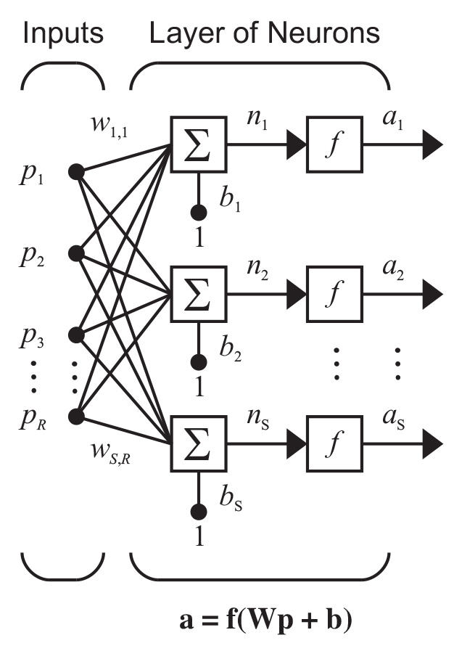

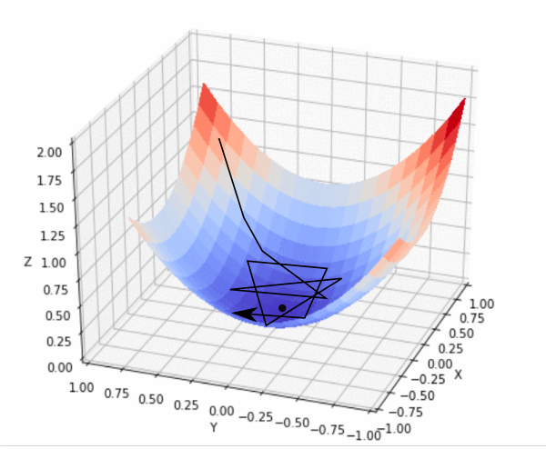
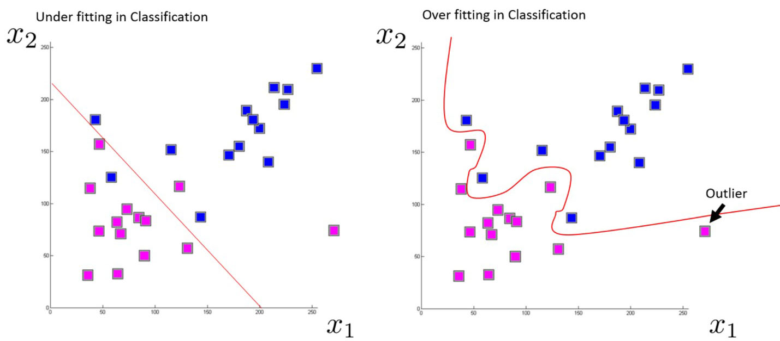
Neural Networks for Cancer Classification: Learning from Data
While there are many good classification algorithms (SVN, Random Forest ...), supervised neural networks are particularly effective
With supervised neural networks:
experts (e.g. pathologists) supply correctly labelled examples;
the network iteratively learns from this Training Set, resulting in a model which, all going well,
generalizes to unseen examples (Test Set)
In more detail:
Start off with random weights (w_{i,i})
process a batch of inputs (p) from the Training Set
quantify batch loss: true ‘minus’ predicted classes
apply chain rull to loss, then update weights
try again with new weights
do this over and over
Periodically validate with examples from Test Set
signet_ring_type
intest_adeno_nos
stom_adeno_diffuse
With pencil: 1 dimensional curve classifying 2 classes
With NN: perhaps 100,000 dimensional hyperplane classifying (say) 6 cancer subtypes
Stack Overflow
With a good model, most iterations will result in the loss (black line) reducing, moving towards the minimun of the (red/blue sheet) corresponding to maximum classification accuracy
DMM Tokyo Machine Learning Tech Talk – Microsoft Startups
Intro to optimization in deep learning: Gradient Descent

Slide 4
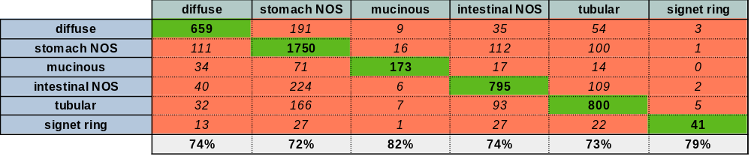
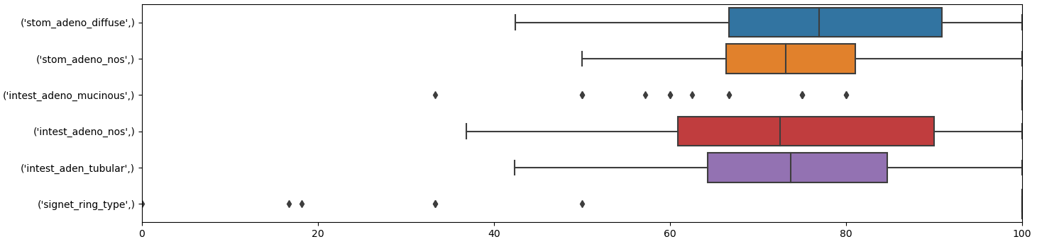
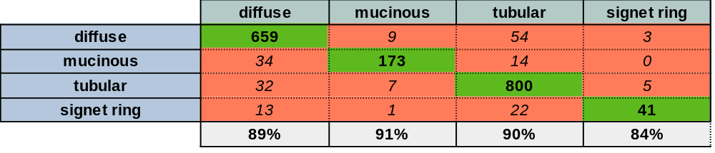
Preliminary Results: 479 TCGA STAD RNA-Seq Samples
Predicted vs True class for held out samples. Aggregated over 60 runs
Classification of 479 TCGA STAD RNA-seq samples (Six subtypes)
Each example = 60,483 mRNA + lnRNA Upper Quartile FPKM values (Frequency per kilobase per million reads mapped)
479 RNA-Seq examples: 80% (383) training set + 20% (96) held out test set. 95 x 60 = 5,760 total predictions over 60 runs
Each of the 60 runs produces a slightly different optimised model (see box plot)
Neural Network details: three layer fully connected network (relu + softmax activation); ADAM. Reasonably well optimised
Observations:
Classification accuracy ranges from 72-82% (all subtypes)
Misclassification to NOS accounts for most misclassifications (makes sense, as NOS is a heterogeneuous catch-all subtype)
Classification accuracy rises to 84-91% when the two NOS categories removed
Classification of held out test sets for each run (=5,760 predictions) - All Six Subtypes
As above, but with the two NOS Subtypes Removed

Slide 5
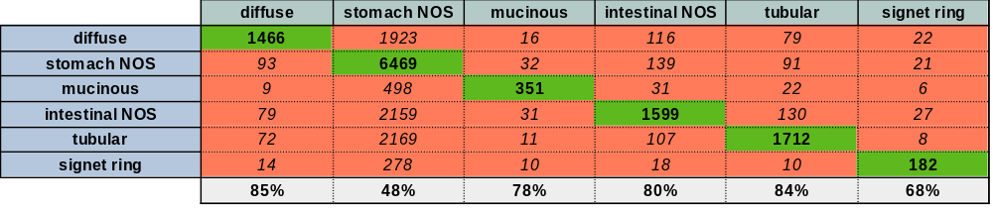
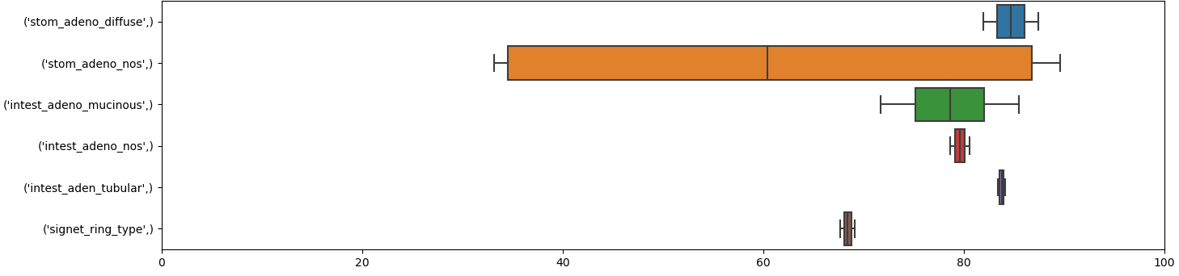

Preliminary Results: 229 TCGA STAD Whole Slide Image Samples
Predicted vs True class for held out samples. Aggregated over 4 runs
Classification of 229 TCGA STAD H&E stained tissue samples (Six subtypes)
Each sample is represented by 2500 64x64 tiles, chosen at random
572,500 tiles: 80% (452,500) training set + 20% (114,000) held out test set. 114,000 x 4 = 912,000 total predictions over 8 runs
Each of the 8 runs produces a slightly different optimised model (see box plot)
Neural Network details: eleven layer convolutional (relu + softmax activation); ADAM. Reasonably well optimised
Observations:
Classification accuracy ranges from 68-85% (all subtypes)
Misclassification to NOS accounts for most misclassifications (makes sense, as NOS is a heterogeneuous catch-all subtype)
Classification accuracy rises to 83-94% when the two NOS categories removed
Classification of 5000 held out tiles for each run (=20,000 predictions) - All Six Subtypes
As above, but with the two NOS Subtypes Removed

Slide 6
Thesis Objectives
Aim 1
Establish a baseline Experiment System using mainstream machine learning software, techniques and models and use this to test the hypothesis on publicly available data.
Develop the Experiment System (90% complete)
Locate, acquire and pre-process suitable matched experimental data (complete)
Test with WSI data (complete)
Test with gene expression data (complete)
Test with matched WSI + gene expression data (not started)
Aim 2 (not started)
Demonstrate that a multi-modal DL network trained with matched WSI and RNA-Seq data type:
can consistently achieve better classification accuracy than any existing system which uses either WSI or RNA-Seq data
can consistently classify difficult to classify tumours
can consistently classify a dataset of difficult to classify T-Cell Lymphoma defined & provided by PMCC Oncologists.
Stretch objective for Aim 2
Incorporate methylation beta value or copy number alteration (or both) as additional data modes
Aim 3 (not started)
Clinical Translation: Convert the Experiment System resulting from Aim 2 into a useful, usable and clinically relevant support tool for Curators and Pathologists.

Slide 7
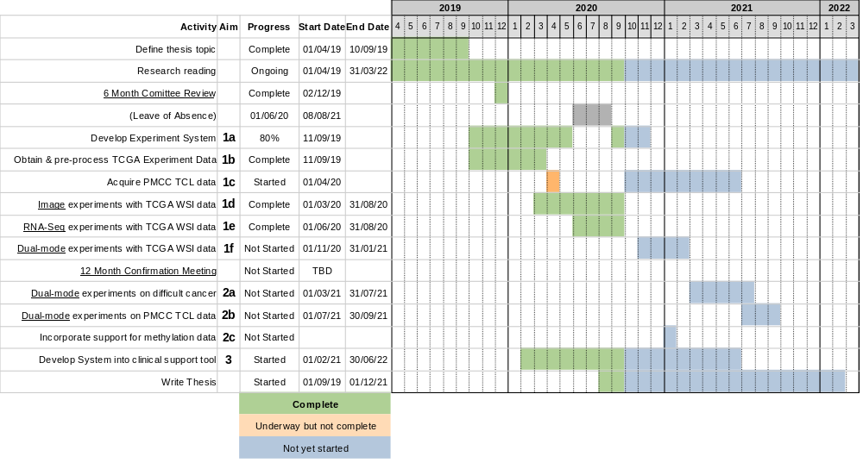
Timeline

